Slide 1
ZUDIO- Retail Sales Data Analytics Project
Tools Used - Python, Pandas , Matplotlib , Power BI , Tableau
Prepared By
Surya M

Slide 2
Project Overview
This project focuses on analyzing ZUDIO- retail sales data to understand:
Sales performance
Product performance
Regional trends
Revenue generation
Profitability patterns
The project combines:
Python for data cleaning and EDA
Power BI for dashboard creation
Tableau for storytelling and business insights

Slide 3
Problem Statement
Retail businesses often struggle to identify:
Which products generate maximum revenue
Which regions perform poorly
Seasonal sales trends
Profitability across products
Hidden patterns in customer purchasing behavior
Without proper analysis, businesses may face:
Poor inventory decisions
Revenue loss
Low profit margins
Weak regional performance
This project aims to solve these challenges using data analytics and visualization techniques.

Slide 4
Project Objective
The main objectives of this project are:
Clean and preprocess raw sales data
Analyze monthly sales and revenue trends
Identify top and bottom-performing products
Analyze regional sales performance
Calculate profitability metrics
Build interactive dashboards for decision-making
Create business storytelling dashboards using Tableau

Slide 5
Python Data Cleaning Process
Steps Performed:
Checked missing values
Filled null values in security features
Converted order date into datetime format
Created new columns like Revenue , Month ,Year ,Day , Profit ratio
Exploratory Data Analysis & Data Visualization:
Monthly Revenue Trend
Sales Distribution
Correlation Heatmap
Purpose of EDA:
Understand sales behavior
Identify patterns and trends
Detect relationships between variables

Slide 6
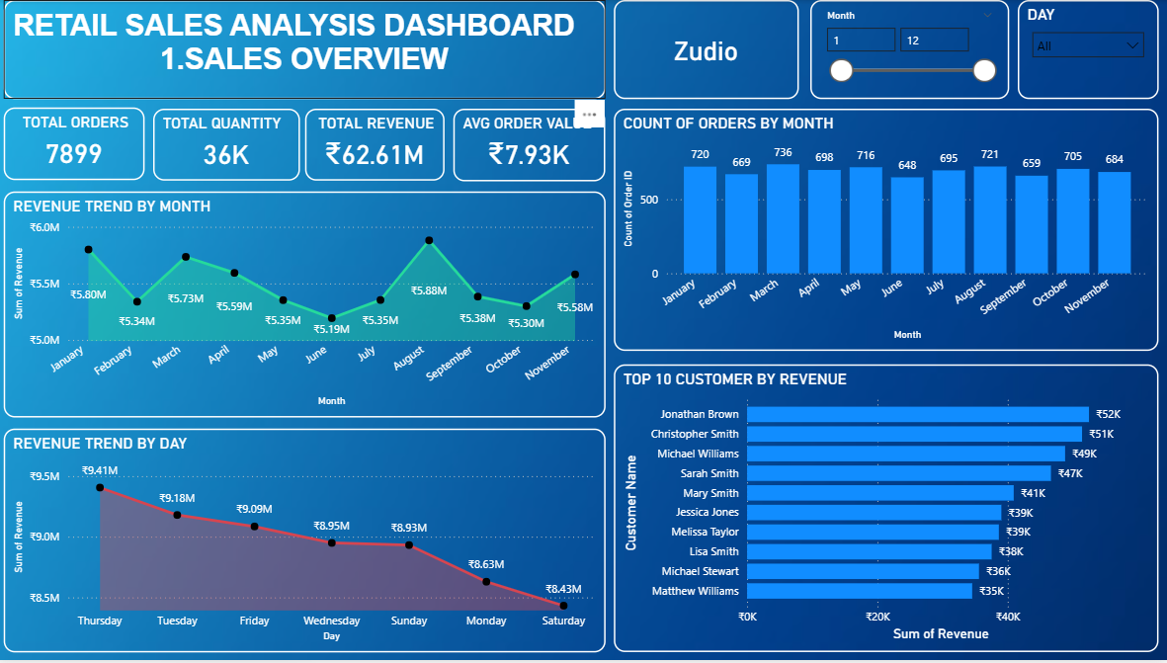
Power BI Dashboard -SALES OVERVIEW
KEY FINDINGS:
1.SALES TREND BY MONTH
August month has highest sales of ₹5.8m
While June month has low sales of ₹5.1m
2.SALES TREND BY DAY
Thursday has highest sales of ₹9.4m in a week
And Saturday has low sales of ₹8.43m
3.CUSTOMER SALES
Jonathan brown makes highest purchase of ₹52k

Slide 7
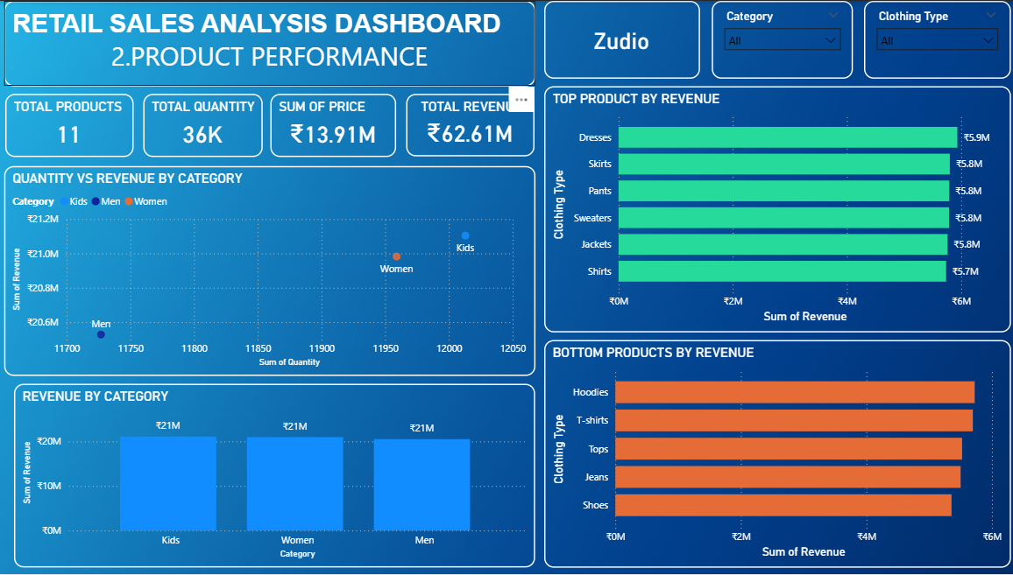
POWER BI DASHBOARD-PRODUCT PERFORMANCE
KEY FINDINGS:
1.Kids category has highest sales of ₹21m and more than 12k of quantity sold
and Men category has lowest sales of ₹20m and 11k of quantity sold
2.TOP PRODUCTS:
-DRESSES has sales of 5.9m
-SKIRTS has sales of 5.8m
-PANTS has sales of 5.8m
-SWEATERS has sales of 5.8m
-JACKETS has sales of 5.8m
3. BOTTOM PRODUCTS:
-HOODIES
-T-SHIRTS
-TOPS
-JEANS
-SHOES

Slide 8
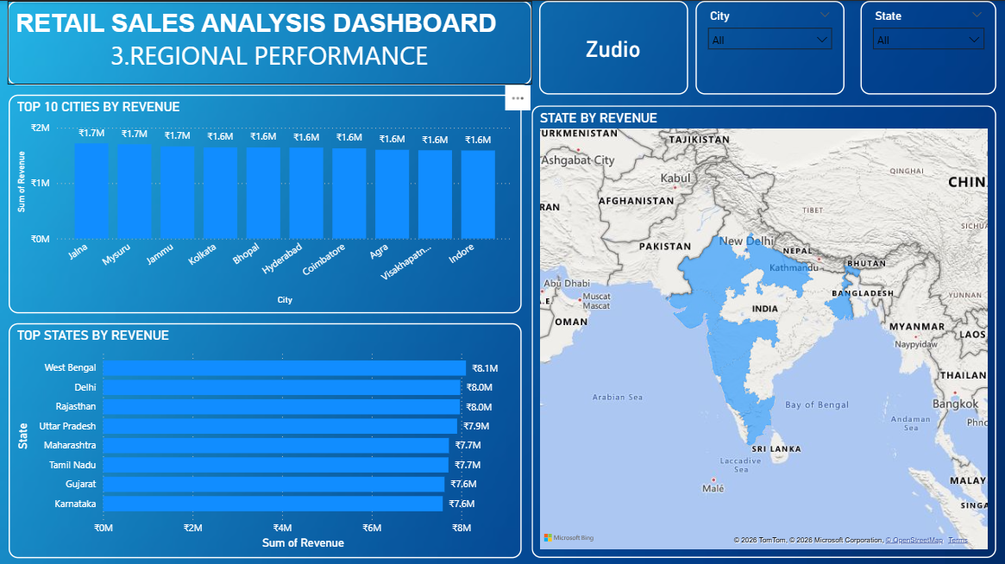
POWER BI DASHBOARD-REGIONAL PERFORMANCE
KEY FINDINGS:
1.STATES BY REVENUE
WEST BENGAL has high revenue of ₹8.1M and KARNATAKA has low revenue of ₹7.6M
2.TOP CITIES:
-JAHA has sales of ₹1.7m
-MYSURU has sales of ₹1.7m
-JAMMU has sales of ₹1.7m
-KOLKATA has sales of ₹1.6m
-BHOPAL has sales of ₹1.6m

Slide 9
Tableau Storytelling
Tableau was used to create business stories by highlighting:
Top-performing products
Bottom-performing products
Best-performing regions
Weak-performing regions
Purpose
To convert dashboard insights into actionable business decisions using storytelling techniques.

Slide 10
BUSINESS RECOMMENDATION:
1. Focus on August & Thursday Promotions : August has peak sales of ₹5.8M and Thursday has highest daily sales of ₹9.4M. Companies should run special offers, flash sales, and discounts during these peak periods to maximize revenue.
2. Prioritize Kids Category Inventory : Kids category drives the highest sales of ₹21M. Businesses should ensure proper stock availability and introduce new product lines in this category to maintain growth.
3. Improve Men's Category Performance : Men's category has the lowest sales of ₹20M. New designs, targeted marketing campaigns, and pricing strategies should be introduced to boost this category.
4. Strengthen West Bengal & Expand Weak Regions : West Bengal leads with ₹8.1M revenue. Marketing budgets should be increased here while Karnataka (₹7.6M) needs regional campaigns and promotions to improve performance.
5. Revive Bottom Products : Hoodies, T-Shirts, Tops, Jeans, and Shoes are bottom performers. Businesses should consider bundle offers, discount pricing, or seasonal campaigns to clear stock and improve sales.

